Slide 1

Introduction to NLP
DSLA Course
Rohit Padebettu

Slide 2
Types of Language

Slide 3
Artificial Language

Slide 4
Natural Language Processing
Natural language processing (NLP) is the ability of a computer program to understand human speech as it is spoken. NLP is a component of artificial intelligence (AI).

Slide 5
What is a Language?
A Language is composed of a set of all possible Texts

Slide 6
What is a Text?
A Text is composed of a sequence of words from Vocabulary

Slide 7
What is a Vocabulary?
A Vocabulary is composed of a set of words

Slide 8
Applications of NLP
Optical Character Recognition

Slide 9
Applications of NLP
Speech Recognition

Slide 10
Applications of NLP
Speech Synthesis & Spoken dialog systems

Slide 11
Applications of NLP
Spelling and Grammar Check

Slide 12
Applications of NLP
Word Prediction

Slide 13
Applications of NLP
Information Retrieval

Slide 14
Applications of NLP
Document Categorization

Slide 15

Applications of NLP
Question Answering and Summarization

Slide 16
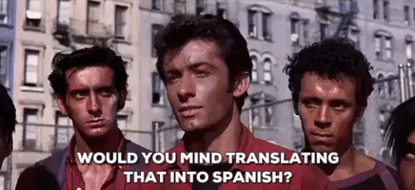
Applications of NLP
Machine Translation

Slide 17
Applications of NLP
Sentiment Analysis

Slide 18
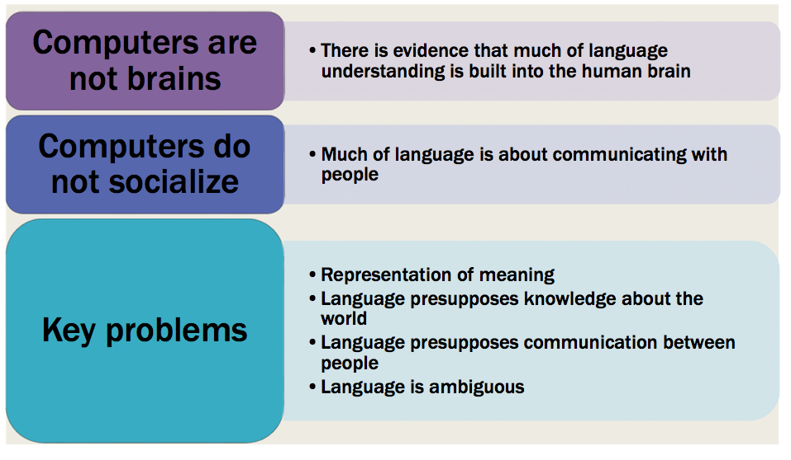
What makes NLP difficult

Slide 19
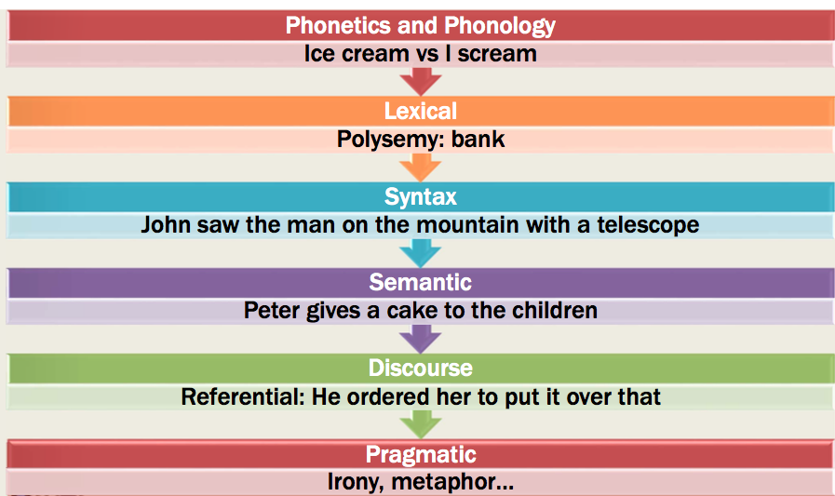
Ambiguity

Slide 20
Paraphrasing
Different words/sentences express the same meaning
Book delivery time
When will I receive my book?
When will my book arrive?

Slide 21
Ambiguity
Same words/sentences express different meaning
Fall
The third season of the year
Moving downwards towards the ground or towards a lower position
The door is open
Could be expressing a fact
Could be a request to close the door
Could mean you can speak to me anytime

Slide 22
Phonetics and Phonology
Two or more words sounding the same, but having different meanings
“I have a knot question. Will you not progress faster by sailing at 20 knots rather than railing about how you should not sail at all? Do you know knots or do you know not?”
And, you know, it would be all right for you to write and practice these patterns every day, because you want to master these skills, right?

Slide 23
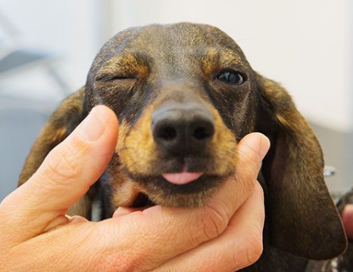
Syntax Ambiguity
In syntactic ambiguity, the same sequence of words is interpreted as having different syntactic structures
Look at the dog with one eye
I saw the man with a telescope

Slide 24
Semantic Ambiguity
In semantic ambiguity the structure remains the same, but the individual words are interpreted differently
The Astronomer loves the star
Star in the sky?
Celebrity?

Slide 25
Pragmatic Ambiguity
Pragmatics concerns the overall communicative and social context and its effect on interpretation
Clouseau: Does your dog bite?
Hotel Clerk: No.
Clouseau: [bowing down to pet the dog] Nice doggie. [Dog barks and bites Clouseau in the hand]
Clouseau: I thought you said your dog did not bite!
Hotel Clerk: That is not my dog.
Can you pass the salt?
Request to pass the salt ?
Physical ability to pass the salt ?

Slide 26
Discourse Ambiguity
Relates to entities previously introduced and processing it requires shared knowledge or world. Interpretation is carried out using this context
Alice understands that you like your mother, but she …
Does she refer to Alice?
Does she refer to your mother?
The horse ran up the hill. It was very steep. It soon got tired
Does it refer to hill?
Does it refer to horse?

Slide 27
NLP - Techniques
Splitting
Splitting Text into Section
Splitting Sections into Sentences
Splitting Sections into Words/Ngrams

Slide 28
NLP - Techniques
Part of Speech tagging
I ate the spaghetti with meatballs.
Pro V Det N Prep N
John saw the saw and decided to take it to the table.
PN V Det N Con V Part V Pro Prep Det N

Slide 29
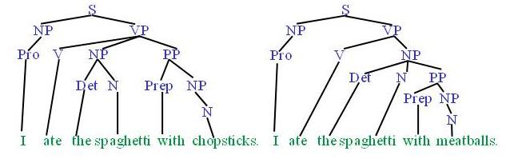
NLP - Techniques
Parsing Syntactic Tree

Slide 30
NLP - Techniques
Named entity recognition

Slide 31
NLP - Techniques
Word Sense Disambiguation

Slide 32
Assignment
For some humor !
What type of ambiguity?
Groucho Marx: One morning I shot an elephant in my pajamas. How he got into my pajamas, I’ll never know.
She criticized my apartment, so I knocked her flat.
Noah took all of the animals on the ark in pairs. Except the worms, they came in apples.
Policeman to little boy: “We are looking for a thief with a bicycle.” Little boy: “Wouldn’t you be better using your eyes.”
Why is the teacher wearing sun-glasses. Because the class is so bright.

Slide 33
Natural Language Processing
Break Time

Slide 34
Demo - 1
Introduction to Text Analysis using Tidy Text

Slide 35
Demo - 2
Introduction to Sentiment Analysis

Slide 36
Demo - 3
Twitter Data Analysis

Slide 37
Latent Dirichlet Allocation (LDA)
A Bayesian Unsupervised Learning Model
Each Document is a mixture of Topics
Each Topic is a mixture of words
Each word is drawn from one of those topics

Slide 38
Latent Dirichlet Allocation (LDA)
It’s a way of automatically discovering topics sentences contain
Sentences 1 and 2: 100% Topic A
Sentences 3 and 4: 100% Topic B
Sentence 5: 60% Topic A, 40% Topic B
I like to eat broccoli and bananas.
I ate a banana and spinach smoothie for breakfast.
Chinchillas and kittens are cute.
My sister adopted a kitten yesterday.
Look at this cute hamster munching on a piece of broccoli
LDA
Topic A: 30% broccoli, 15% bananas, 10% breakfast, 10% munching, … (topic A could be about food)
Topic B: 20% chinchillas, 20% kittens, 20% cute, 15% hamster, … (topic B could be about cute animals)

Slide 39
Demo - 4
Topic Modeling using LDA

Slide 40
Course Assignments
Programming Assignments
Reading Assignments
Presentation Assignments
Technical Skills Assignments
Writing Assignments

Slide 41
Twitter Case
Twitter User Analysis
Build a set of tools to later (next week) use to build a Shiny App
Tools:
Build an LDA model using tweets downloaded from a few distinct topics
Given a twitter user (fairly famous users)
Based on his tweets, guess the topics he is interested in and compare it to his description
Do a sentiment analysis of the timeline of his/her tweets and present it
Display a word cloud or bag of words of what the twitter user uses
Find and compare his top 5 best followers
Given a tweet, estimate the top 3 topics it might be classified as and show it graphically

Slide 42
Technical Assignment
Teach yourself Shiny
https://shiny.rstudio.com/tutorial/

Slide 43
Programming Assignment
Code Submission on Github for Twitter Case

Slide 44
Reading Assignment
Read Chapter 6: Linear Model Selection & Regularization

Slide 45
Writing Assignment
Submit by Saturday
Written Report (not to exceed 15 pages) on Twitter Case

Slide 46
Presentation Assignment
By Saturday Submit
Your Presentations on Twitter Case
Technical Presentation
Business Presentation (Not to exceed 5 slides)

Slide 47
Natural Language Processing
Lunch

